Slide 1
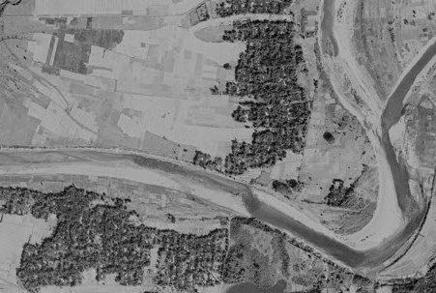
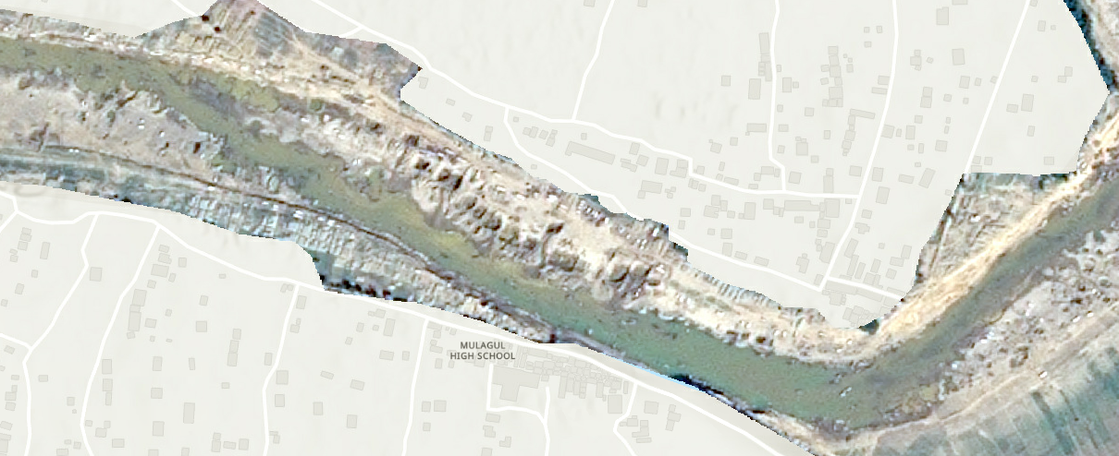
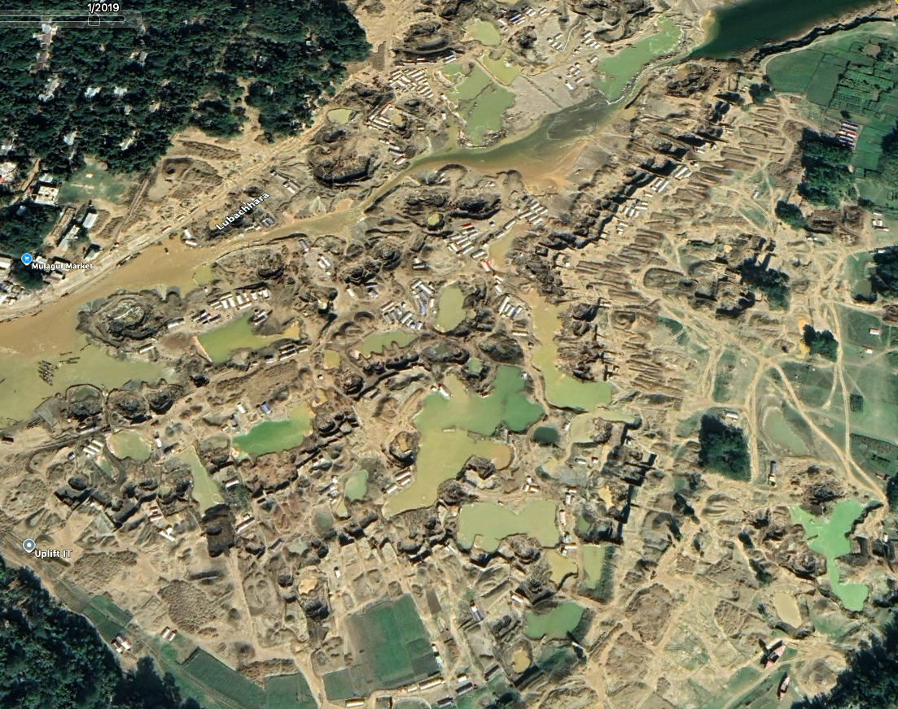
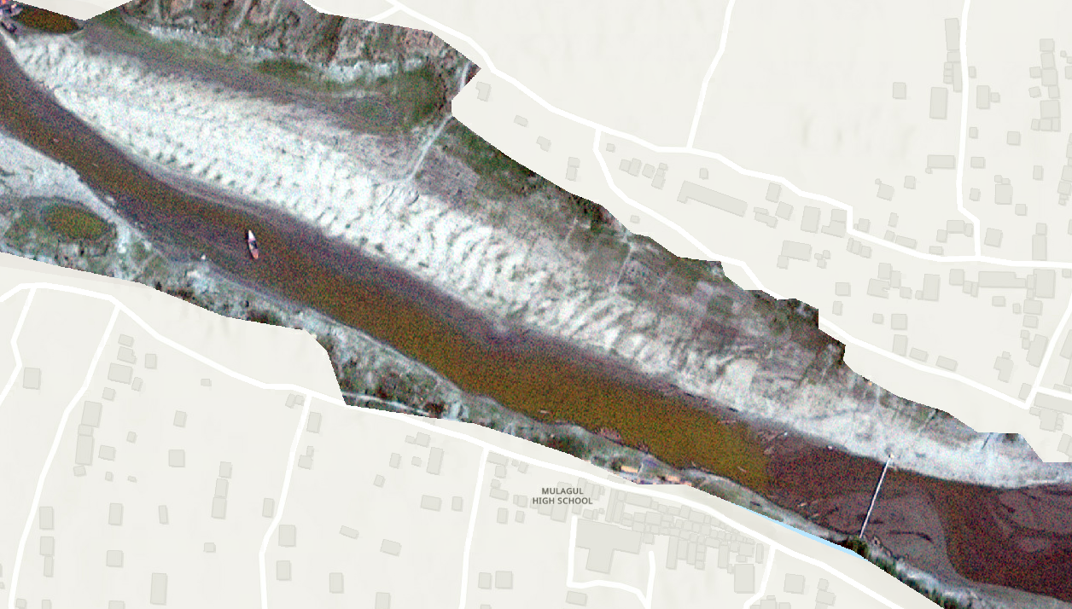

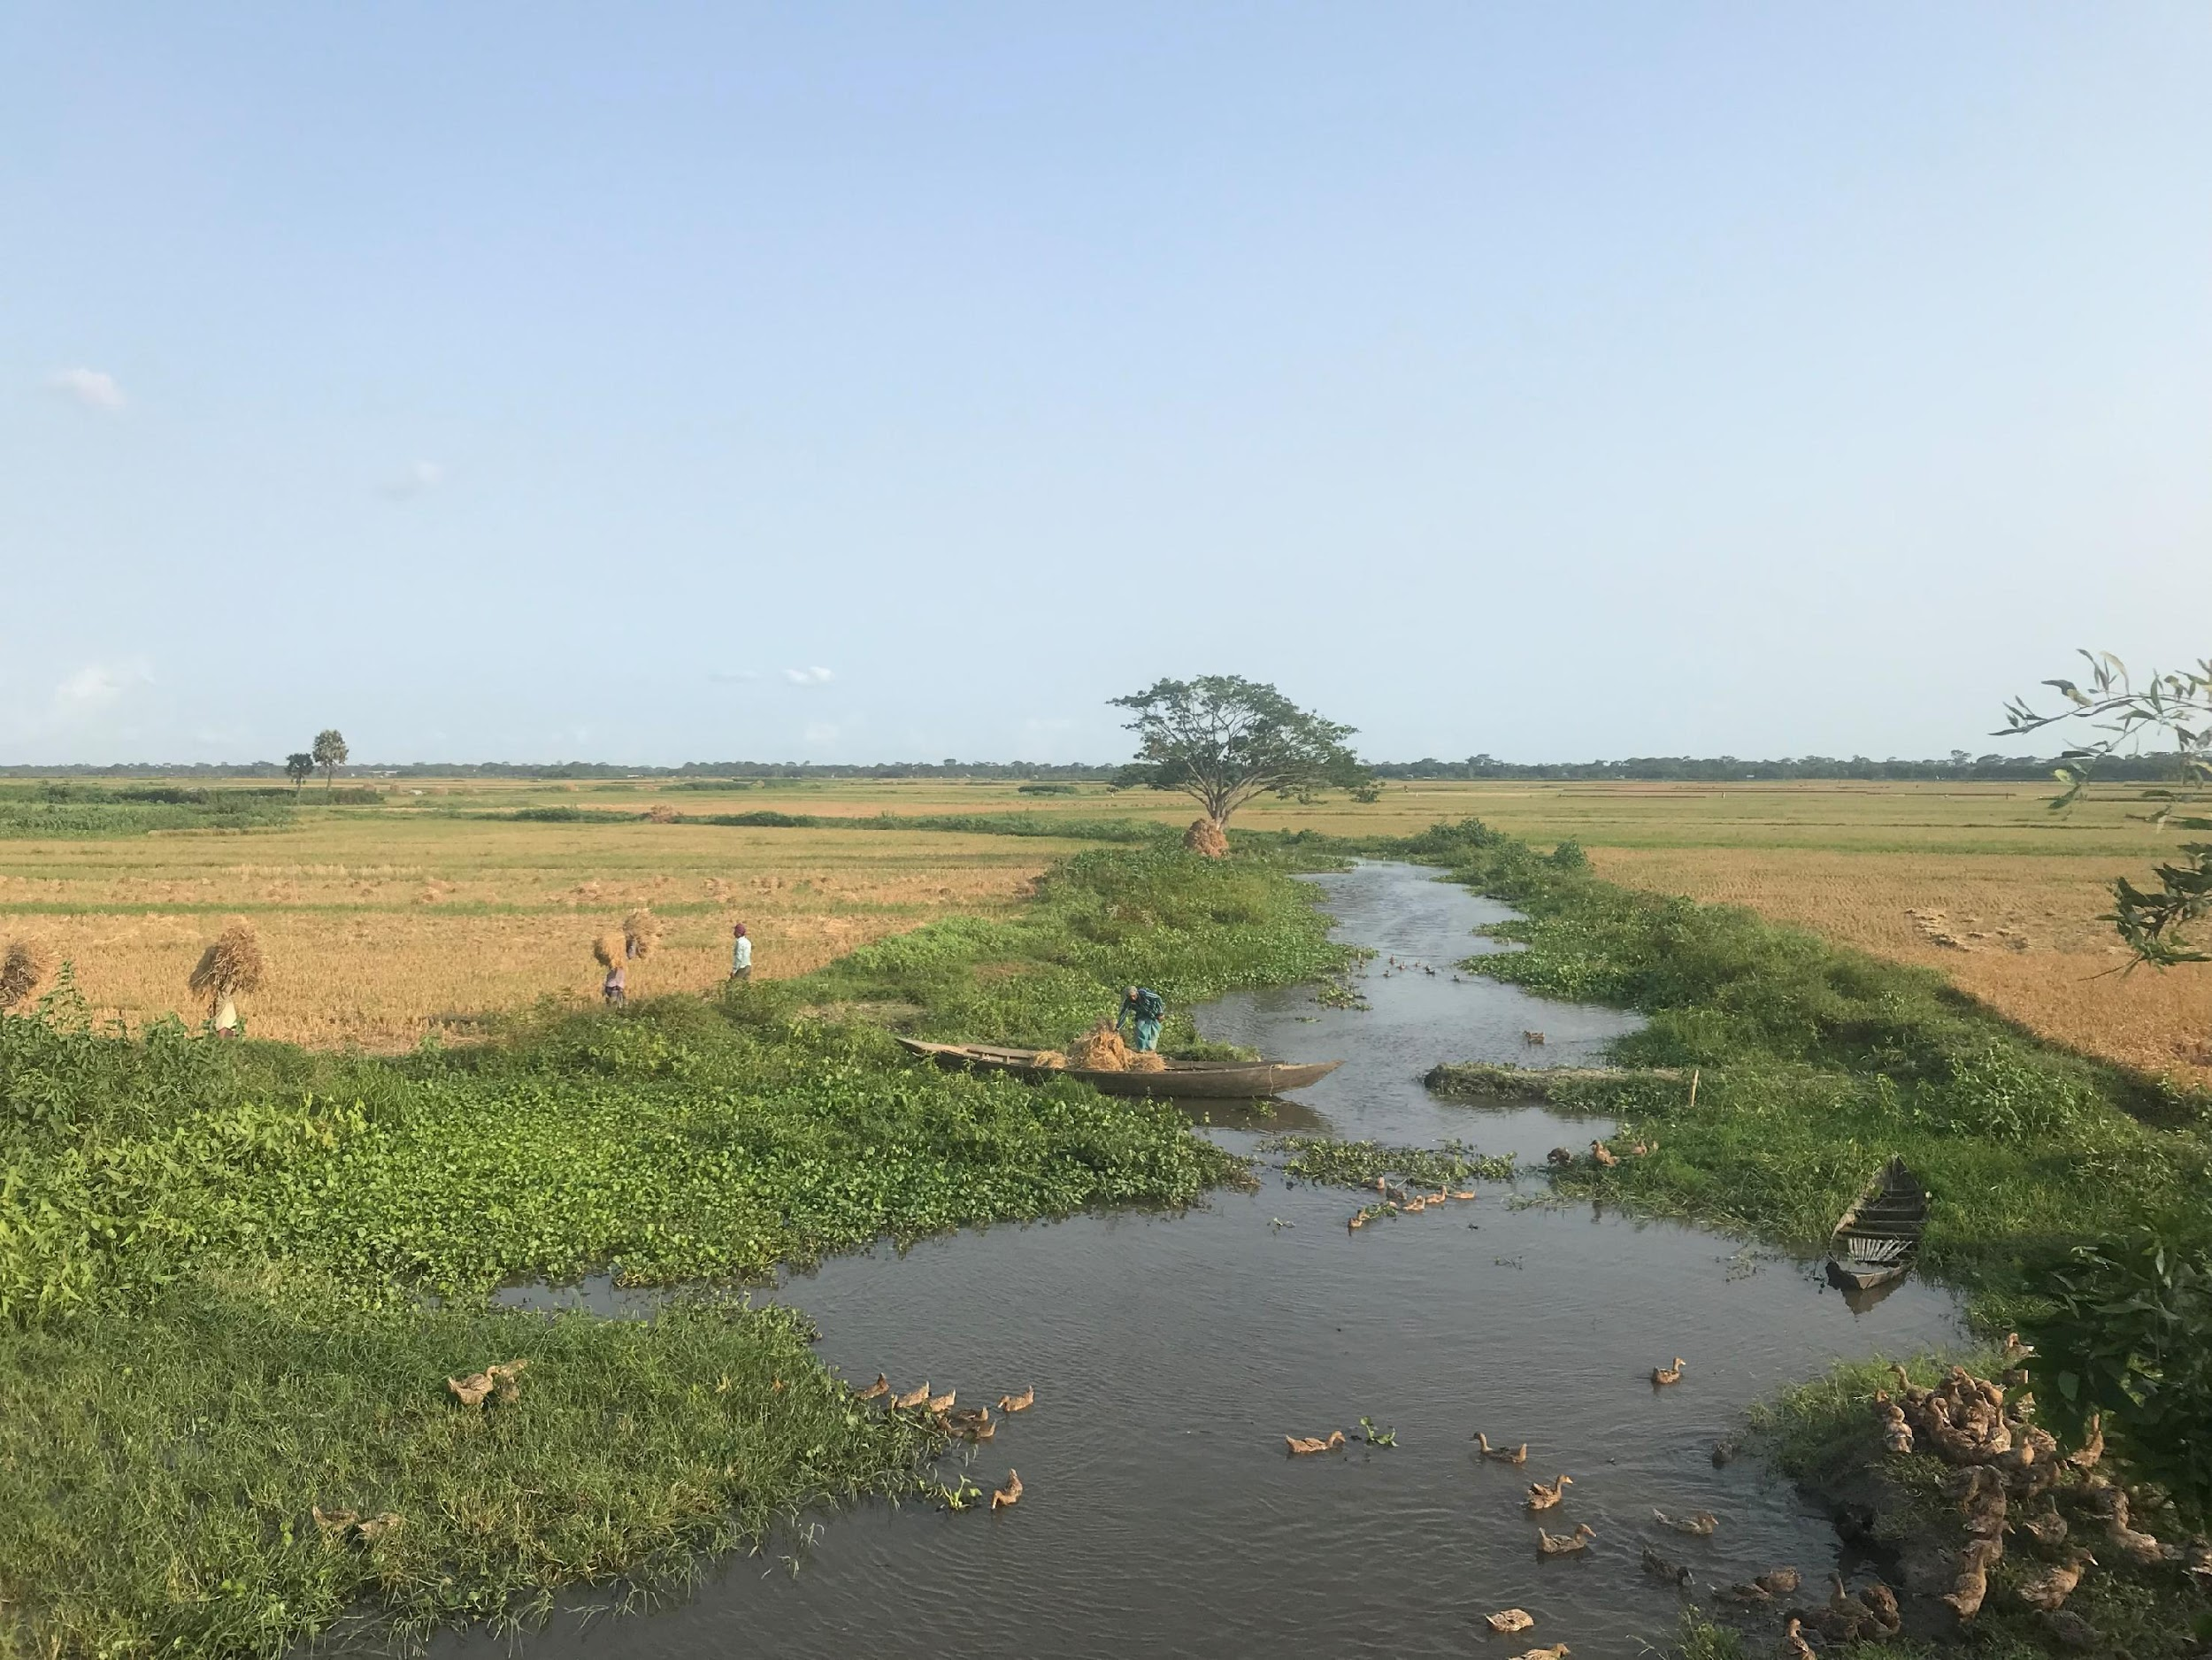
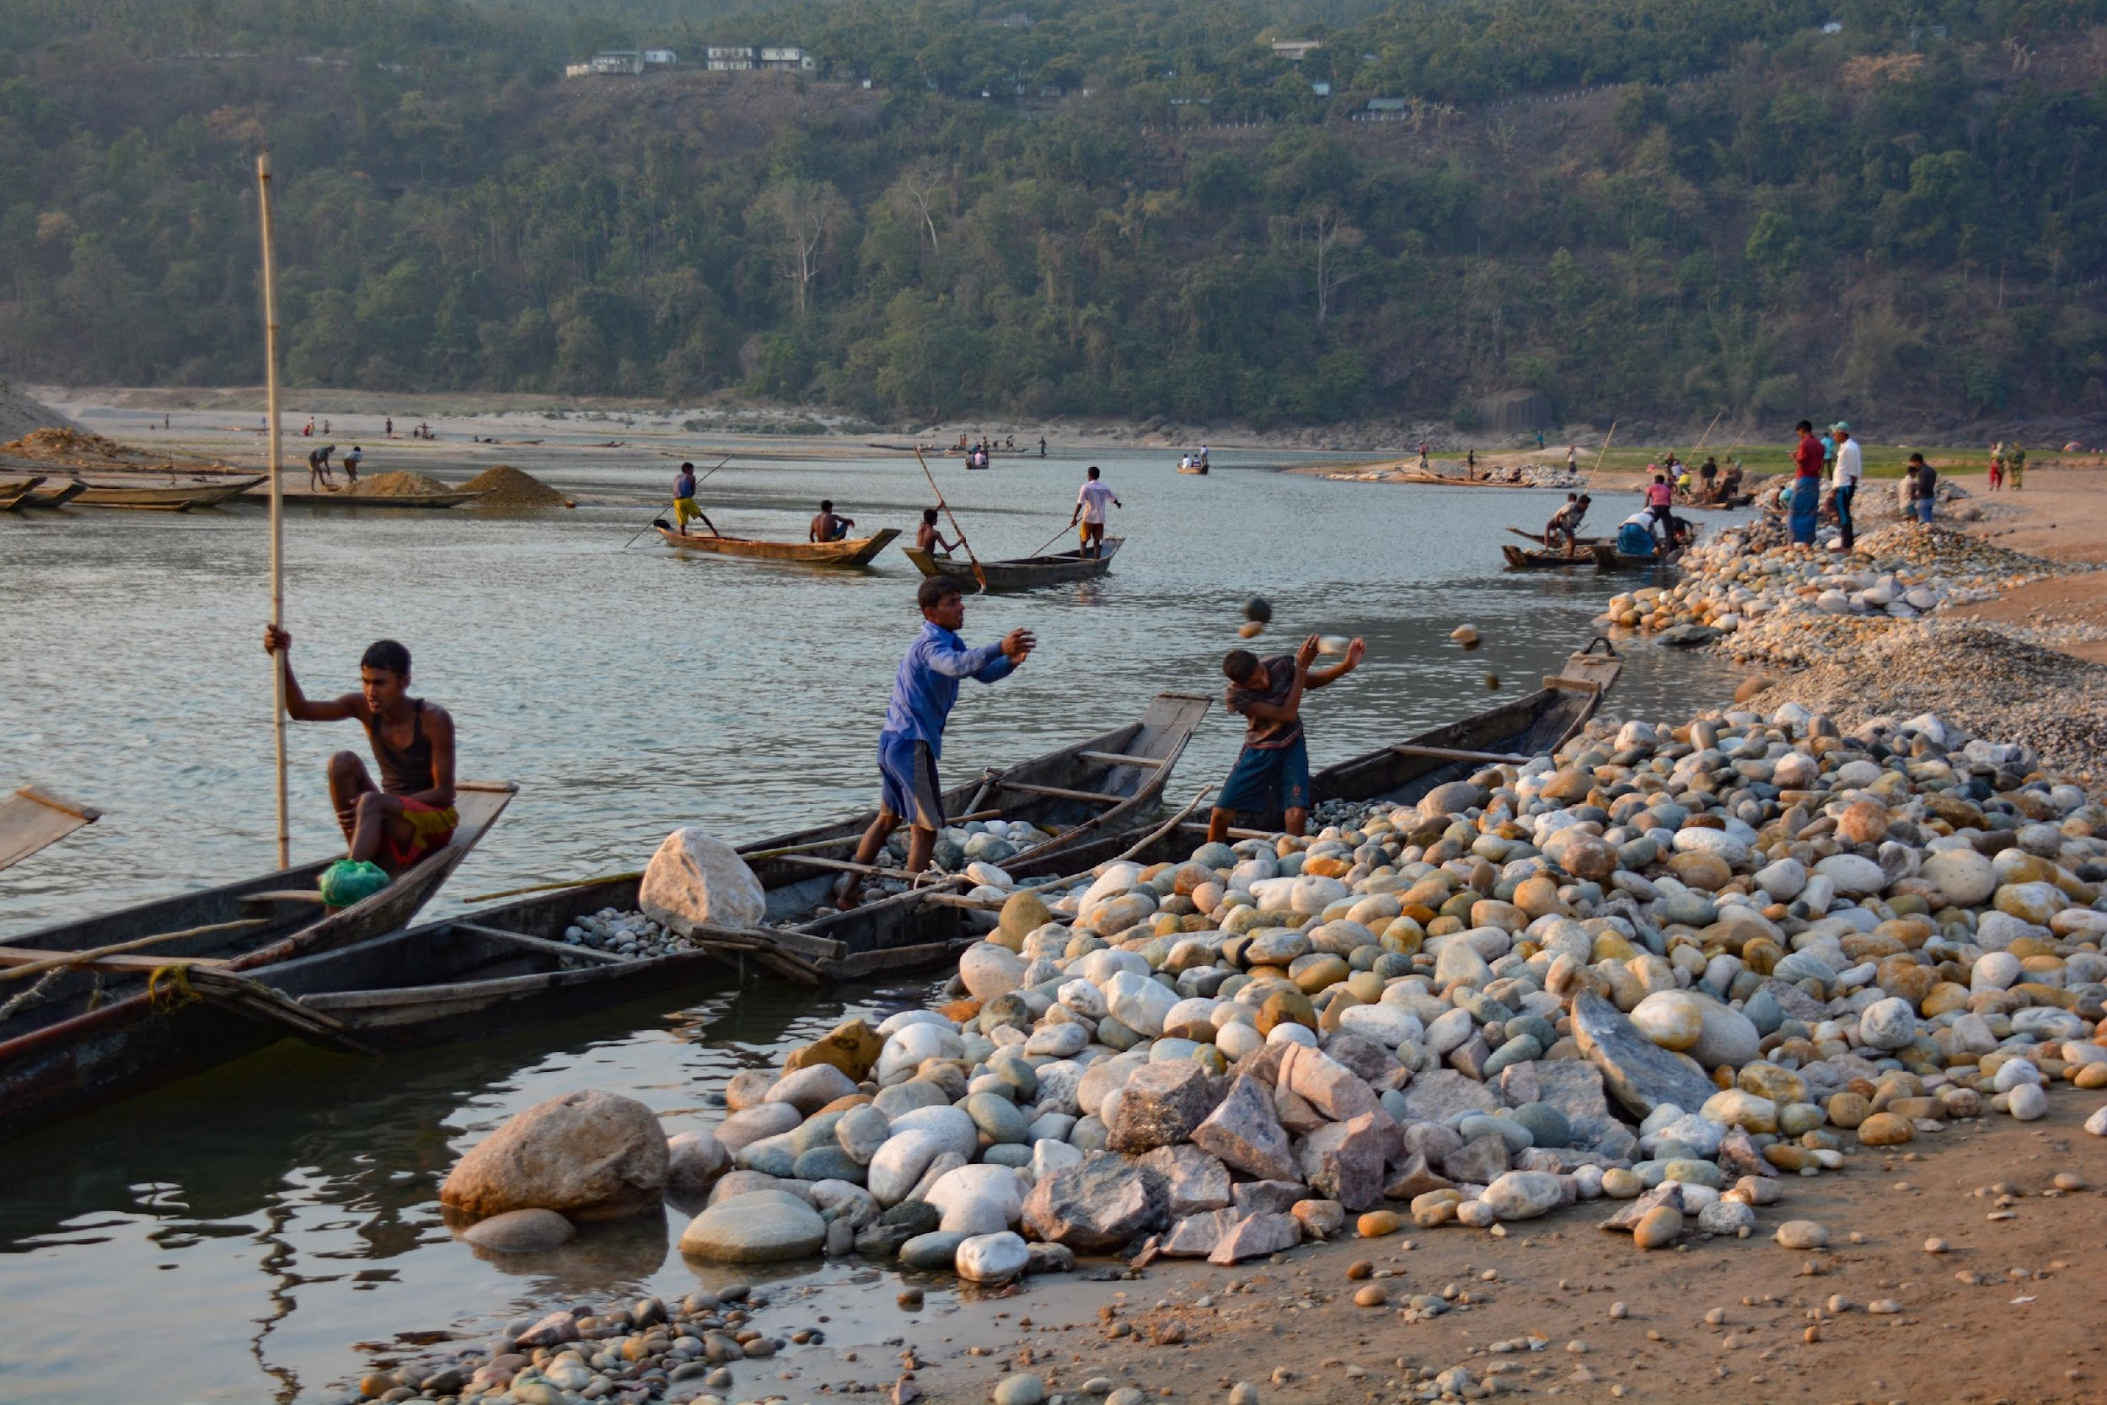
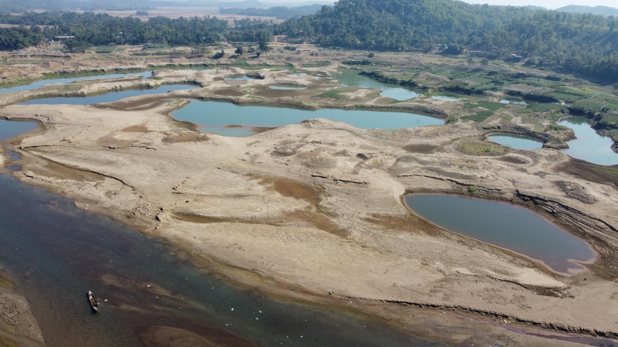
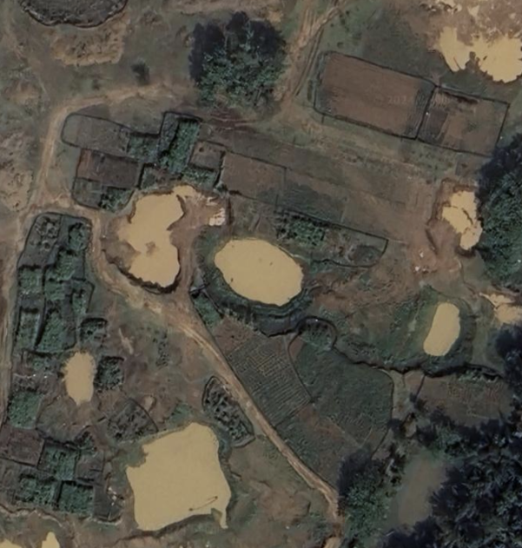
pristine riverine landscape
artisanal pit mining in river
scarred floodplain & abundant barracks
gravel dune formation
Active Channel Extraction Dominance
Abandoned Channels/Floodplain Extraction
Pre-Extraction
Recovery
Policy Guidance
1972
2012
2015
2017
2020
2021
2024
Environmental impact
assessment
Mining
ban
granted
by courts
Mining
ban
enacted
Channel Extraction Abandoned Channels/Floodplain Extraction Migrant worker population
Gravel volume
extracted
Migrant worker
population
Time
crop fields before extraction
artisanal local labor-based mining
mechanized extraction
re-cultivation

